Slide 1




BUILD A CAREER TRACKER PLATFORM FOR SKILLED YOUTH

Slide 2
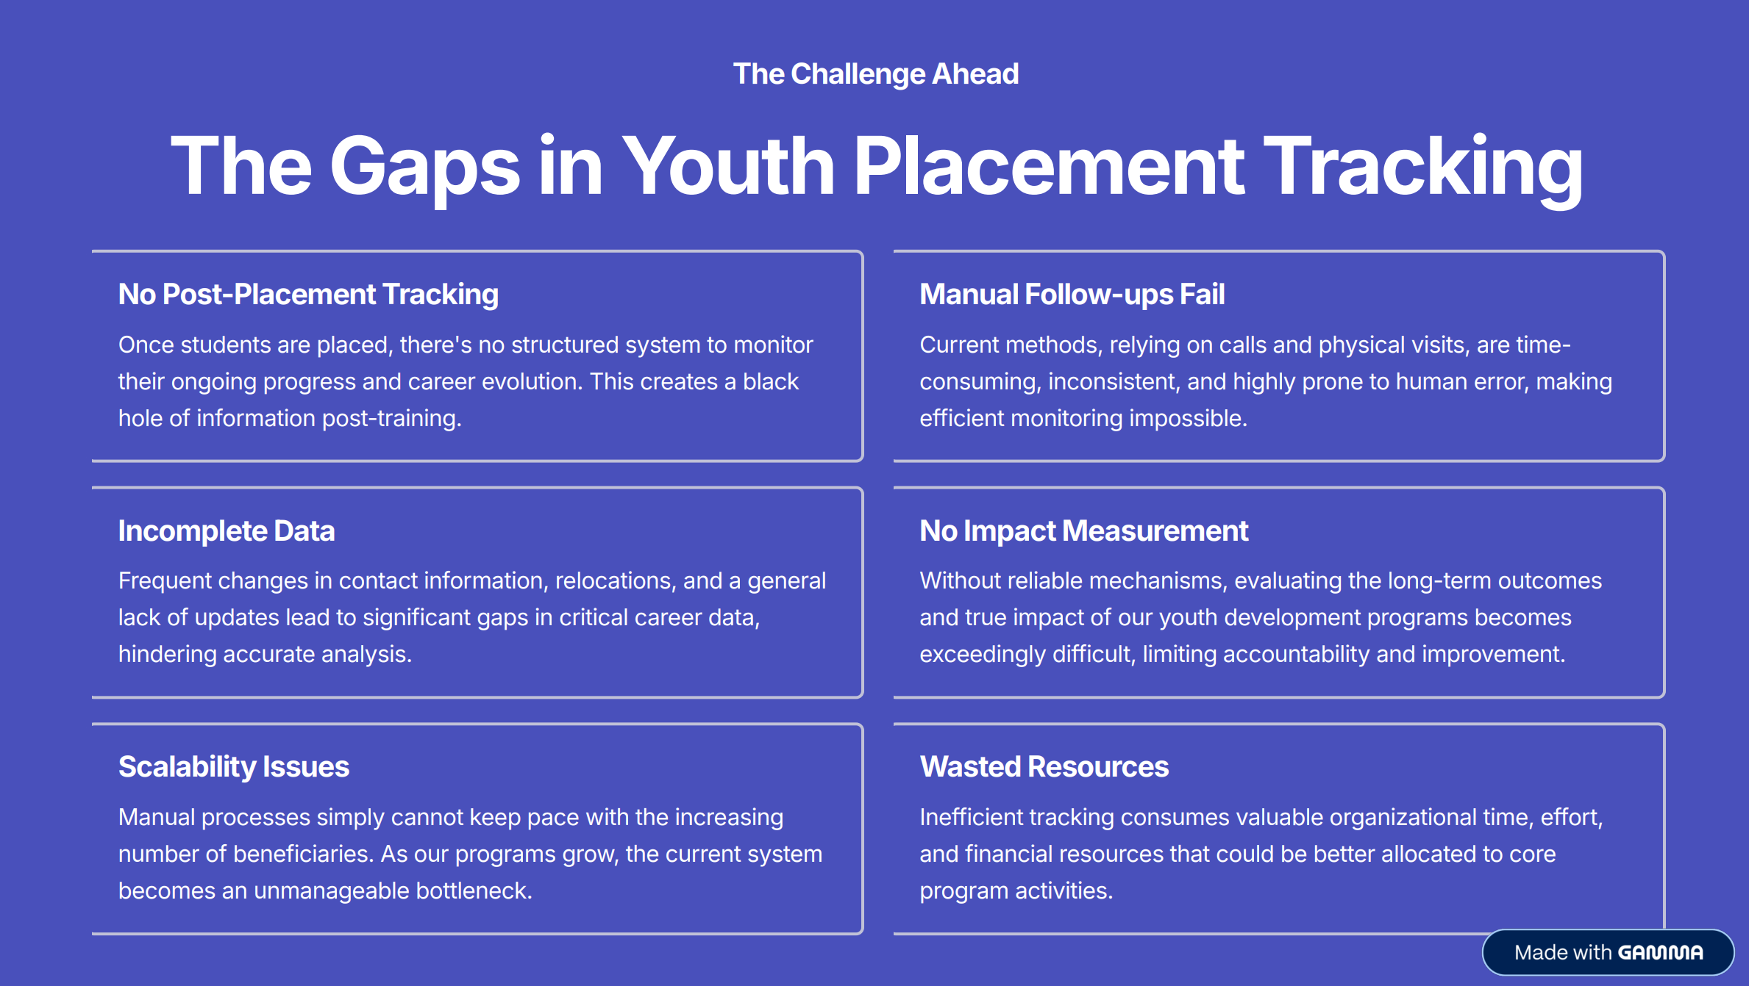

Slide 3
Problem Statement brief:
No post-placement tracking - Can't monitor beneficiaries after job placement
Manual follow-ups fail - Calls and visits are time-consuming and inconsistent
Incomplete data - Phone changes and migrations cause data gaps
Can't measure impact - No reliable way to assess long-term program success
Scalability issues - Manual processes don't scale with growing beneficiaries
Wasted resources - Inefficient tracking drains organizational time
2
August 20, 2024

Slide 4
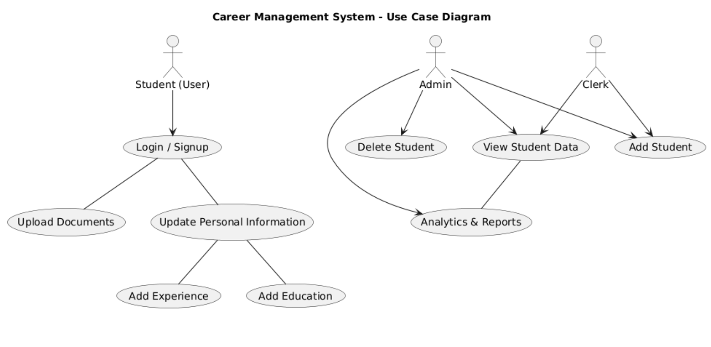
Solution Overview
4
August 20, 2024

Slide 5
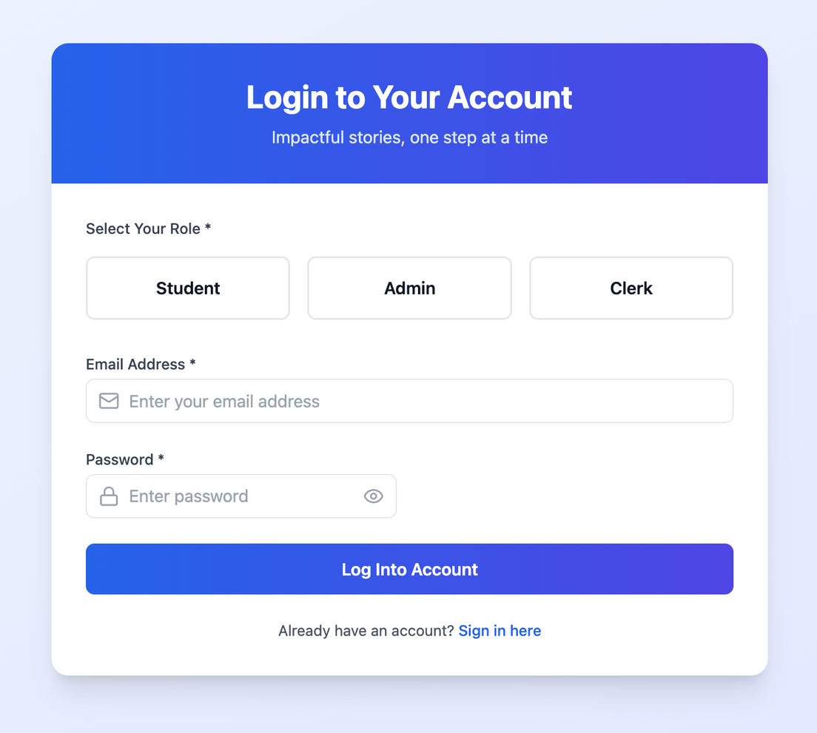
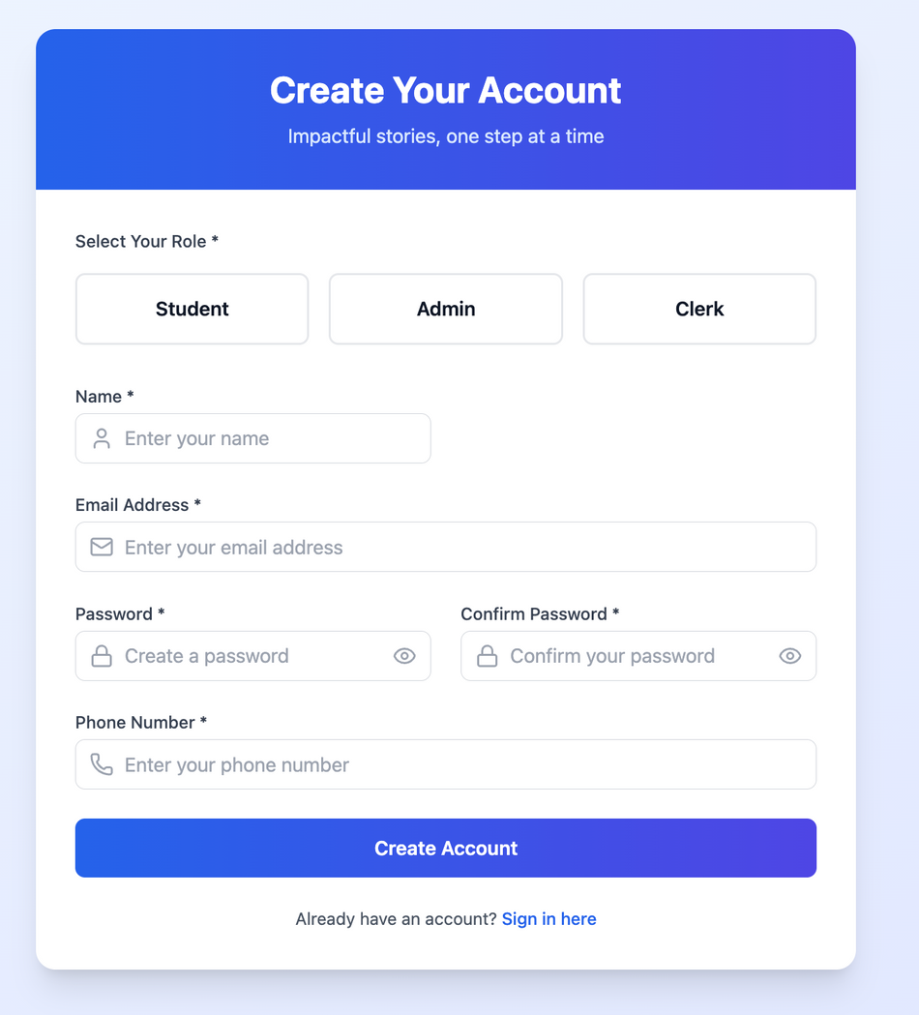
Demo Prototype
https://drive.google.com/drive/folders/15wiWD66NU8OyHou3B06lRceq__D7xXA6?usp=drive_link
4
August 20, 2024

Slide 6
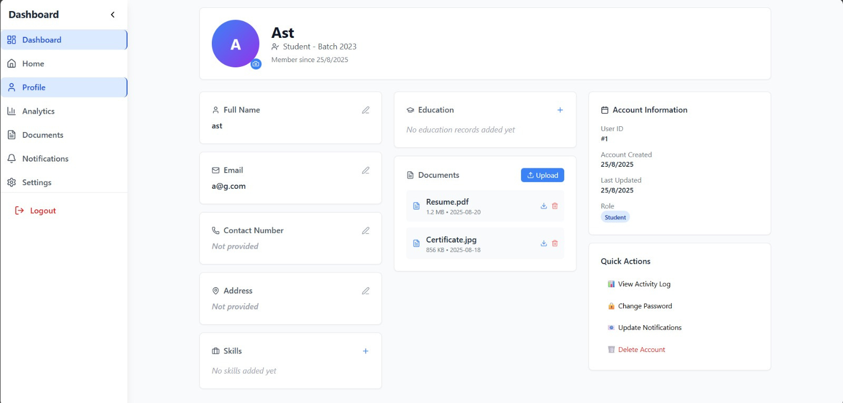
Demo/Prototype
4
August 20, 2024

Slide 7
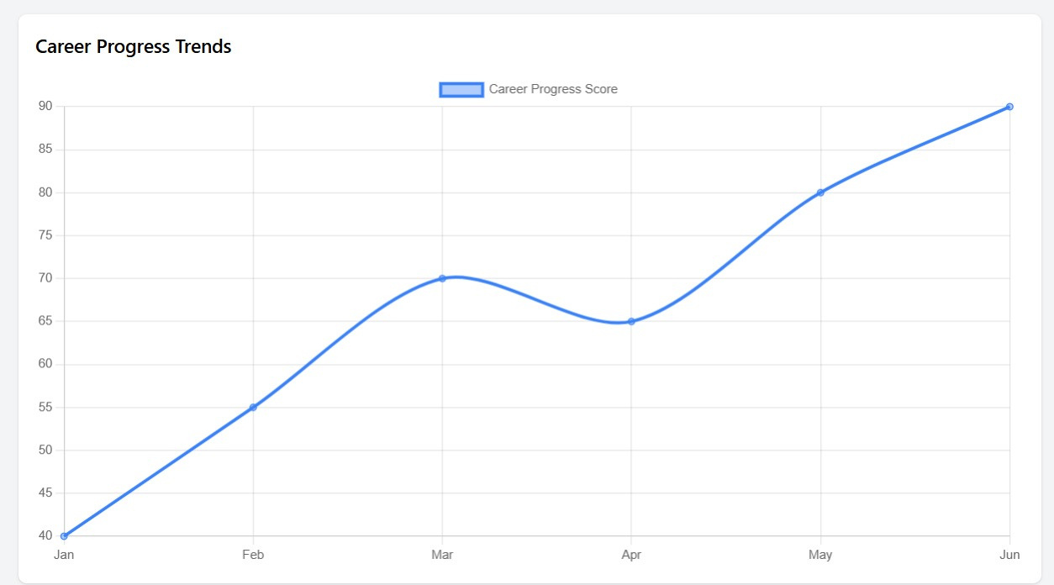
Demo/Prototype
4
August 20, 2024

Slide 8
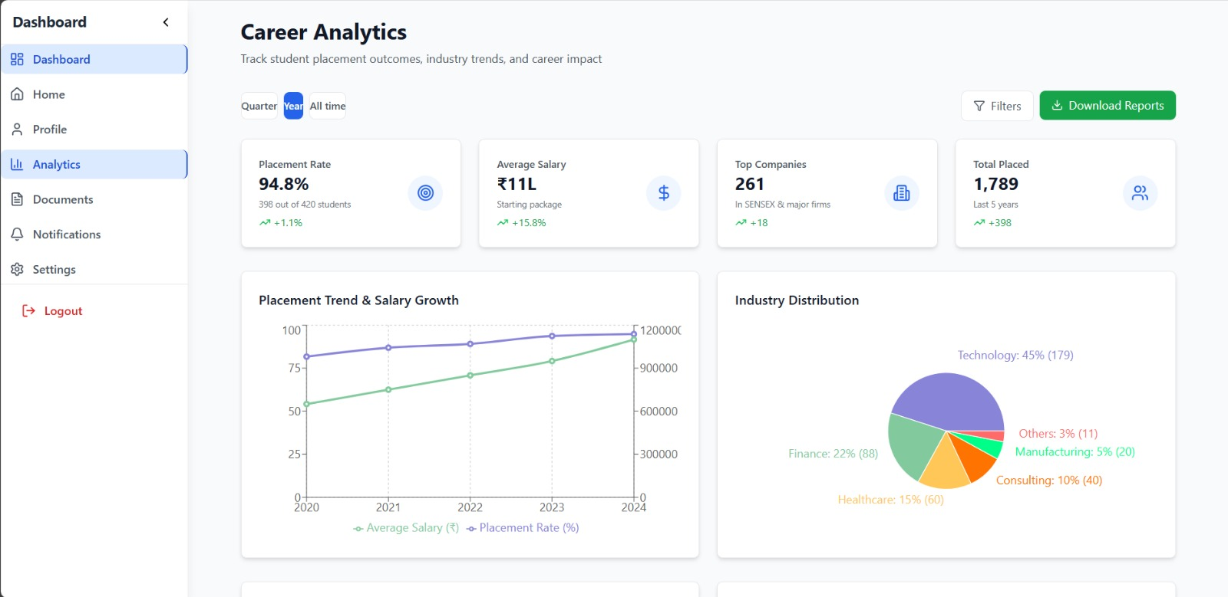
Demo/Prototype
4
August 20, 2024

Slide 9
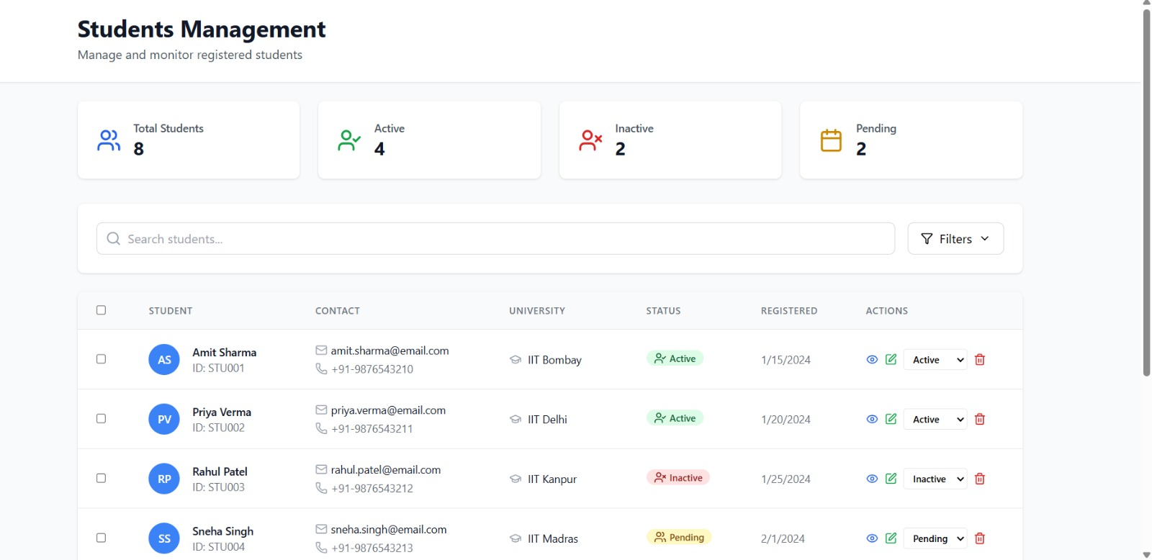
Demo/Prototype
4
August 20, 2024

Slide 10
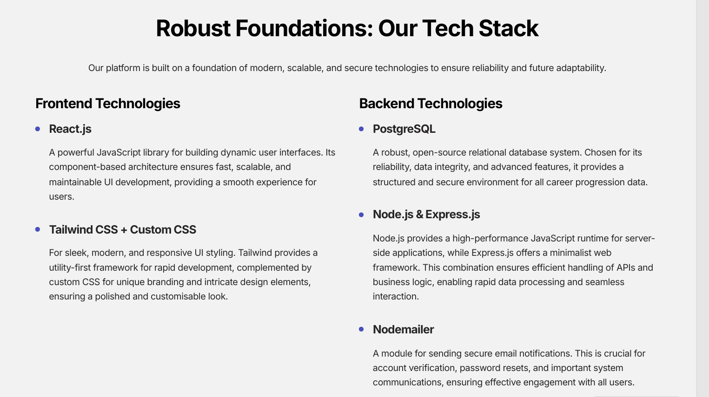

FRONTEND -
React.js
UI Libraries - Tailwind,CSS
Backent -
Postgres
Node.js
Express.js
Nodemailer
GitHub Repository-https://github.com/Mastercard-Code-For-Change-2-0/Team-24
5
August 20, 2024

Slide 11
Impact/Future scope
Scalability:
Expand to multiple NGOs and training institutes
Government database integration
Enhanced Features:
AI-powered career recommendations
Mobile app with offline capability
Revenue Streams:
Organization subscription fees
Data insights services
Social Impact:
Improved employment tracking accuracy
Better career outcomes for youth
6
August 20, 2024

Slide 12
DRIVE LINK-
Your paragraph text

Slide 13
Q&A
7
August 20, 2024

